Slide 1
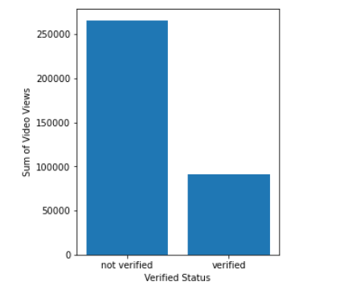
Ecexutive Sumamry
TikTok claim classification project EDA
The project involves dealing with reports filed by user which may be of two types- claims and opinions. Claims are information that do not have valid sources, while opinions are considered to be information that is representative of the author making the video.
The data analysis team was able to group the data by verified status and then find the total sum of the video counts as shown below-
The difference in means between the verified and unverified groups is of statistical difference
It is not due to chance or sampling variability
Thus the findings suggest there might be fundamental behavioural differences between the two groups of people
Could suggest one of the following theories-
Do unverified authors use click-baity tactics to boost view count
Unverified accounts apply to a larger audience while verified authors usually have their niche community.
Barplot of toal view count vs verified status
The next step would be to build a regression model to better understand the two variables and their relationship.
Would be using logistic regression since this is a case of binary classification.

